Slide 1
PEPA Conference
24 April 2024
Andrej Miller - DESNZ

Slide 2




Agenda
OFFICIAL : SENSITIVE
Policy/political landscape
Current and future policies
GBIS and ECO4 delivery
PAS2035
What next

Slide 3

Overall context
OFFICIAL : SENSITIVE
ECO and GBIS until March 2026
Capital funding committed to until 2028
Increase to heat pumps support under Boiler Upgrade Scheme
Greater onus on support than regulation
Expectation that heat pumps will be the dominant heating technology
Clean heat market mechanism
Focus now on implementing and delivering policies rather than new announcements
Huge shift in supply chain and public attitudes over the next 5 years

Slide 4
Announced policies to be implemented
Local authority retrofit scheme
  £500m allocated 25-28
  EPC D-G private homes in England
  Building on LAD and HUG schemes
Energy efficiency grant scheme
  £400m allocated 25-28
  Broad offer for retrofit
  Very early stages of development
Trailblazer devolution deals
  Great Manchester and West Midlands will receive flexible funding for retrofit
  Part of the £6bn capital funding announced in December
  DESNZ to set outcomes/outputs – flex in how they are achieved
  Pilot launch in April 2025

Slide 5
Social Housing Decarbonisation Fund
Wave 2.1 in delivery and expected to treat around 90,000 homes
Total investment of nearly £1.9bn
Wave 2.2 is top up
  £75m funding allocated with £139m of private investment
  Delivery until March 2026
Wave 3
  £1.25m of government funding to 2028
  Over 150,000 homes treated
  Greater focus on heat pumps
  Some changes to policy
  Grant awards from autumn

Slide 6
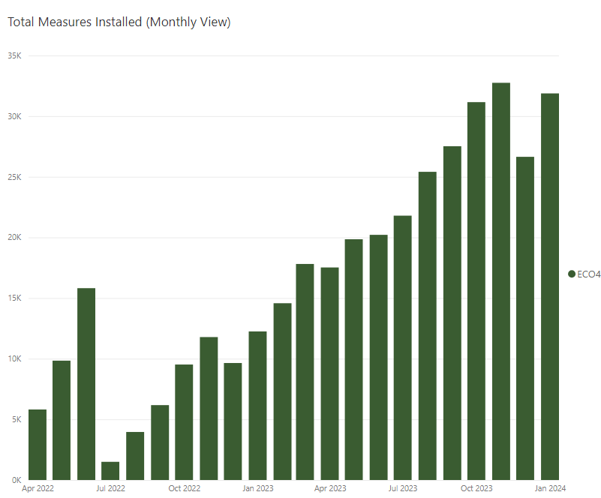
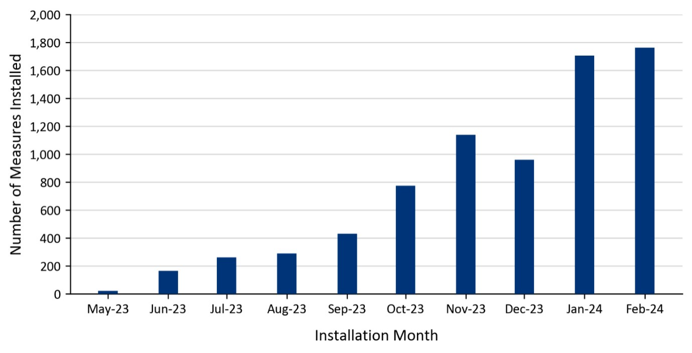
OFFICIAL : SENSITIVE
ECO4 and GBIS delivery
ECO4 delivery on track in terms of legal target – high number of measures, lower number of homes
GBIS delivery slower than expected
Considering changes to GBIS though would require public consultation and change to regulations
GBIS – monthly measures
ECO4 - monthly measures
Notes:
GBIS is a high priority for government and ministers are very aware of the low number of installations.
Lord Callanan met with energy suppliers at the end of March to discuss how delivery could be improved. That discussion included options for changes to the policy. Ministers are now considering those options.
All changes to the policy would require a public consultation. Other than the potential introduction of TrustMark Licence Plus for loft insulation (for GBIS), policy changes would also require a change to the regulations.
The above also applies to ECO4. No decisions have been taken on whether there will be changes to ECO4 policy, including regarding the solid wall minimum requirement.
ECO and GBIS regulations can only be changed when Parliament is sitting. Summer recess for Parliament begins on 23 July and an autumn general election would mean that it may not sit again until the next government is in place.
Therefore, it is likely that any policy changes to either scheme (which require a change to regulations) will come into place in Q1 2025 at the earliest.

Slide 7
PAS 2035 update
PAS 2035/2030:2023 was published in September 2023 and is freely available for download. ​BSI webinar covering the changes freely available here. ​
Transition period of 18 months set to allow time for industry to adopt changes introduced in the PAS 2035/2030:2023 documents (re-certifying, adapting PAS 2035 software, etc)​
Transition ends 30 March 2025 after which BSI will withdraw the previous versions and retrofit projects must be carried out in accordance with 2023 version. ​
DESNZ is working with TrustMark on minimising the disruption for long-term delivery projects under schemes which have already started under the previous standards and will be communicating any further guidance in due course. ​
TrustMark have made functionality changes to the Retrofit Portal to allow lodgements under PAS 2035/2030:2023.
​

Slide 8
What next
Decisions for next government:
  Any domestic role for Hydrogen?
  Regulations – public acceptance, supply chain, compliance, enforcement, standards
  Gas vs electricity price
  How much can be bill funded
  How much fabric alongside heat pumps
  Mix of policies – delivery models
  All homes/fuel poverty
Role of SAP/HEM and performance measurement

Slide 9
Thank you
OFFICIAL : SENSITIVE

